Slide 1
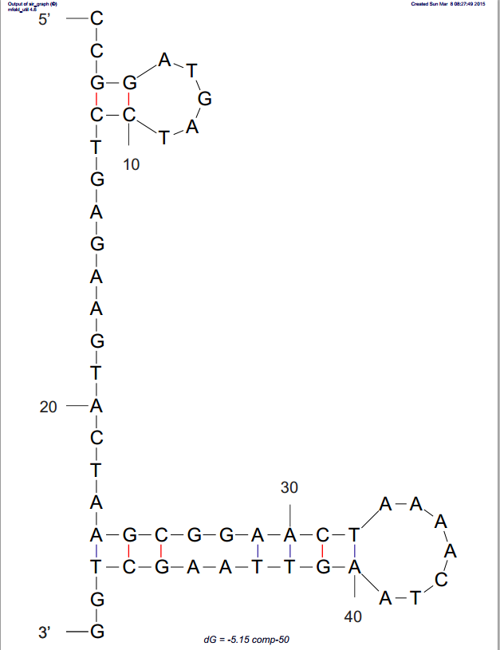
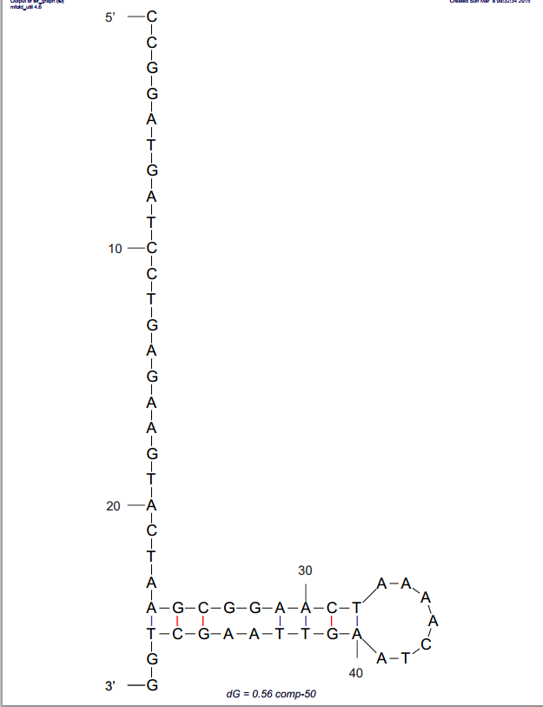
Run Sequences
ToeHold-60 |  |  | CCGGATGATCCTGAGAAGTACTAAGCGGAACTAAAACTAAGTTAAGCTGGAATCTCACCC
comp-50 |  |  | CCGGATGATCCTGAGAAGTACTAAGCGGAACTAAAACTAAGTTAAGCTGG
comp-40 |  |  | CCGGATGATCCTGAGAAGTACTAAGCGGAACTAAAACTAA
comp-30 |  |  | CCGGATGATCCTGAGAAGTACTAAGCGGAA
comp-50_mFold_structure @ 25C
delG=-5.15
comp-50_mFold_structure @ 55C
delG=0.56

Slide 9
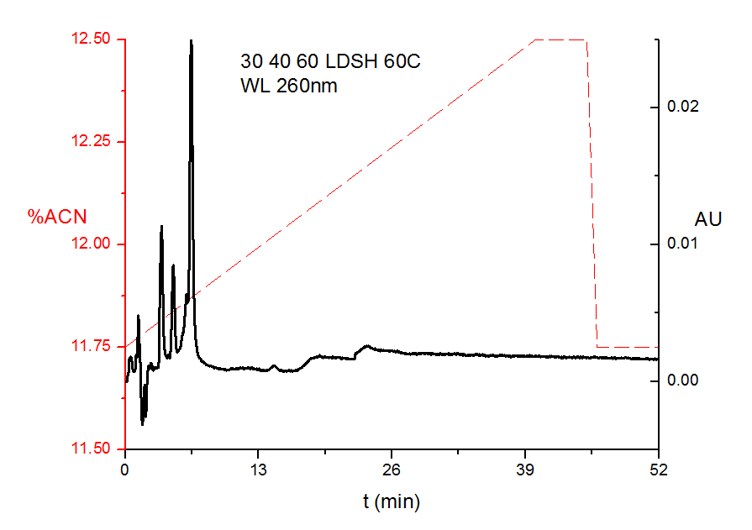

Slide 10
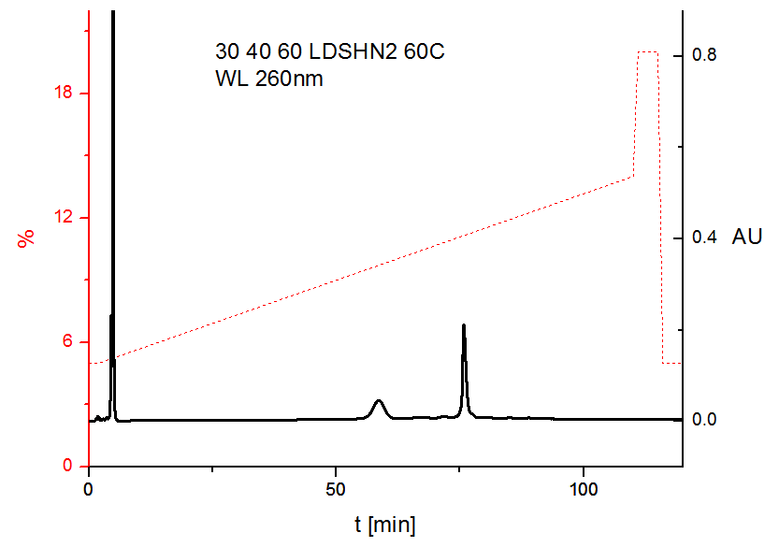

Slide 11
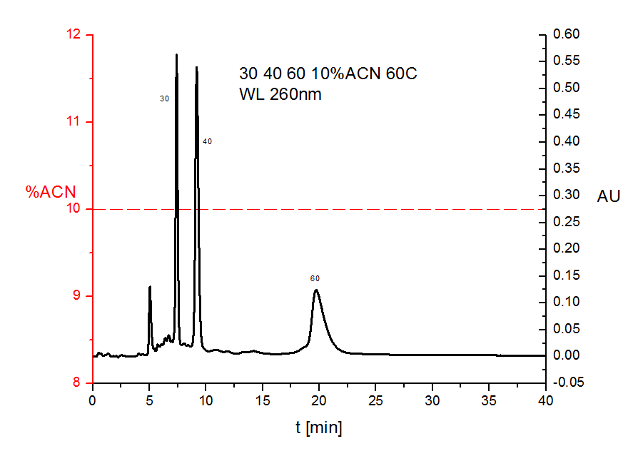

Slide 12
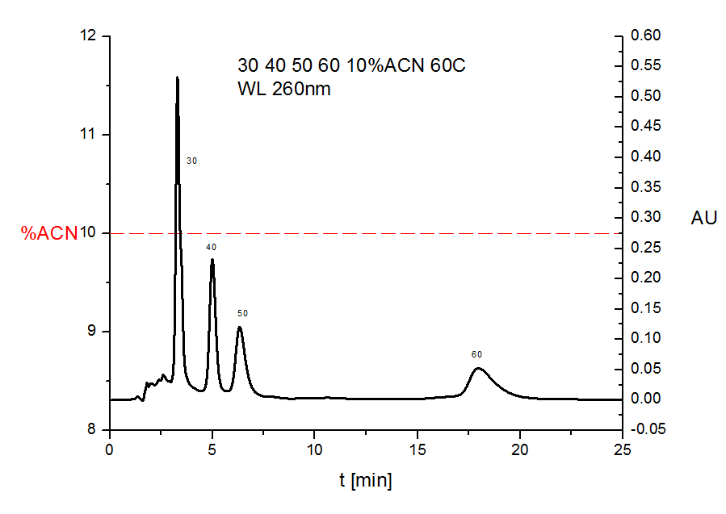

Slide 13
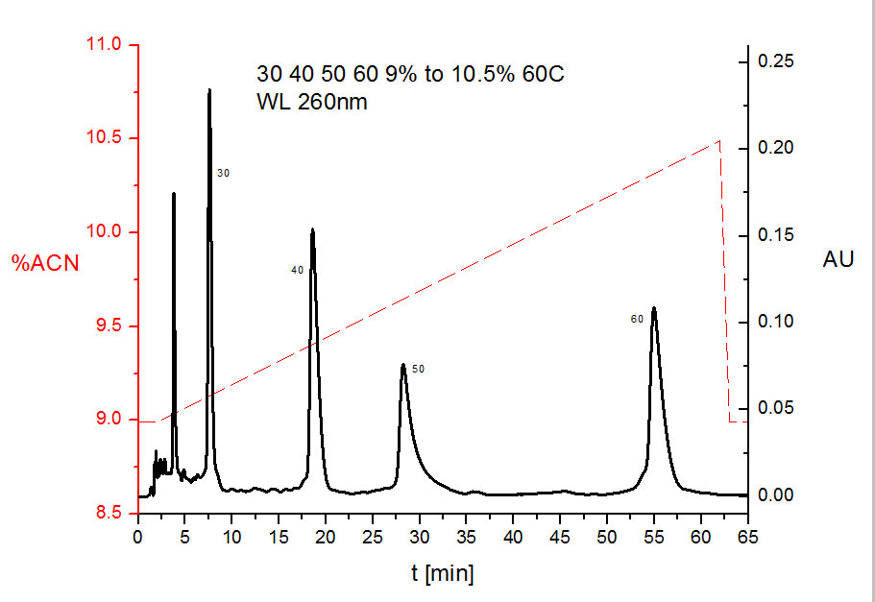

Slide 14
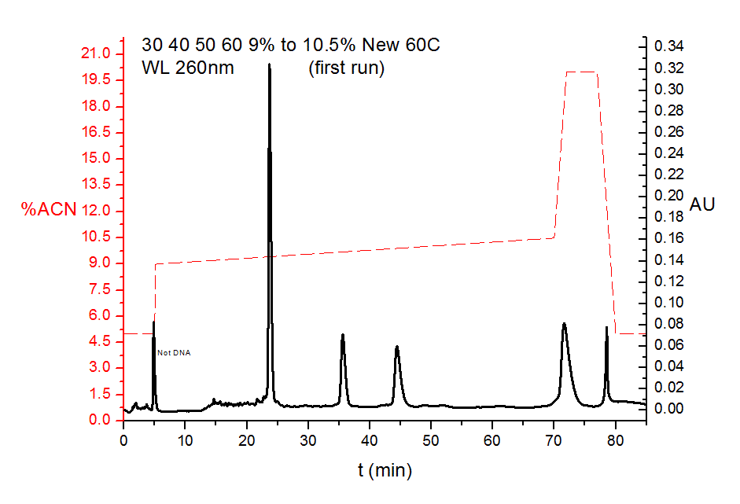

Slide 15
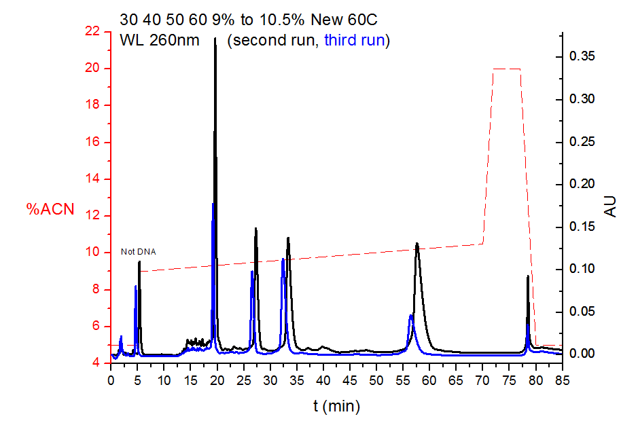

Slide 16
